Slide 1
West Learning Center
Project Based Learning
Study Group
Members: Liz Barvinchak, Jamie Robinson, Mike Wayman, Barb Harris, Tammy Peppard

Slide 2
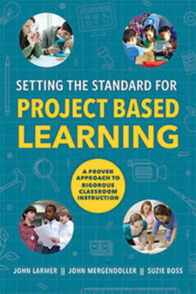
Setting the Standard for Project Based Learning
Text: Setting the Standard for Project Based Learning
Authors: John Larmer, John Mergendoller, Suzie Boss

Slide 3
Chapter 1: Why Project Based Learning?
Motivate students
More active, hands-on learning
21st century skills
Success skills: Communication, Collaboration, Critical Thinking, Creativity

Slide 4
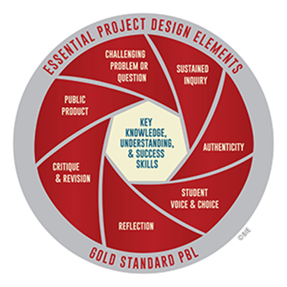
Chapter 2: What is Gold Standard PBL?

Slide 5
Chapter 3: What Does the Research Say About Project Based Learning?
PBL higher or the same as traditional instruction
Deeper learning
Develop success skills
Learn with understanding
Retain what learned
Apply learning to new contexts

Slide 6
Chapter 4: Designing a Project
5 Types of Projects
Solving a Real-world Problem
Meeting a Design Challenge
Exploring an Abstract Question
Conducting an Investigation
Taking a Position

Slide 7
Step 1: Consider your context
Which students
When
How complex
How long will it be
How many subjects

Slide 8
Step 2: Generating an Idea for a Project
Customize someone else’s project -
Peanut Butter and Jelly Sandwich Construction
Generating your own idea
Keep the Heat Project, Ancient Greece Scrapbook

Slide 9
Step 3: Building the Framework
Setting the learning goals
Knowledge/understandings and success skills
Selecting major products
Artifact, event, performance
Deciding how projects are made public
Public display(poster), Event (performance), Publish (digital)
Writing a driving question
Engaging, open ended, aligned with learning goals

Slide 10
Chapter 5 Managing a Project
Building the culture
Work in teams, active listening, sharing and building on ideas
Modeling
Open ended not having the “right” answer
Critical thinking and problem solving
Brainstorm, give and receive critique, evaluate information
Technology used
Skill level or need to be taught new technology
Create a Project Calendar/ Arrange Resources

Slide 11
Phases of a Project
Phase 1: Launching the Project
Entry event, Driving Question, Form teams, Project journal
Phase 2 : Building Knowledge and Understanding Skills
Scaffolded learning, independent investigation, experts,
Phase 3: Developing , Critiquing and Revising Products
Changes, new information, additional reading, formative assessment
Phase 4: Presenting Products
Answer driving question, decide on product

Slide 12
What we learned
Need for a longer time frame to develop and implement PBL
Building the culture for special education students can adapt to a different way of learning
Better understanding of how to use across different disciplines
Flexibility in allowing a variety of products that can be used for evaluation
Helps to focus more on students disabilities and deficits and develop strategies that will help them succeed
Positive alignment with CDOS Foundation Skills (success skills)
Using a variety of technology that will benefit students in the workplace

